Slide 1
Foot Protection for Employees in the Trades
Prepared by:
Ed Griswold
Safety Specialist
Office of Environmental Health and Safety
Louisiana Tech University

Slide 2
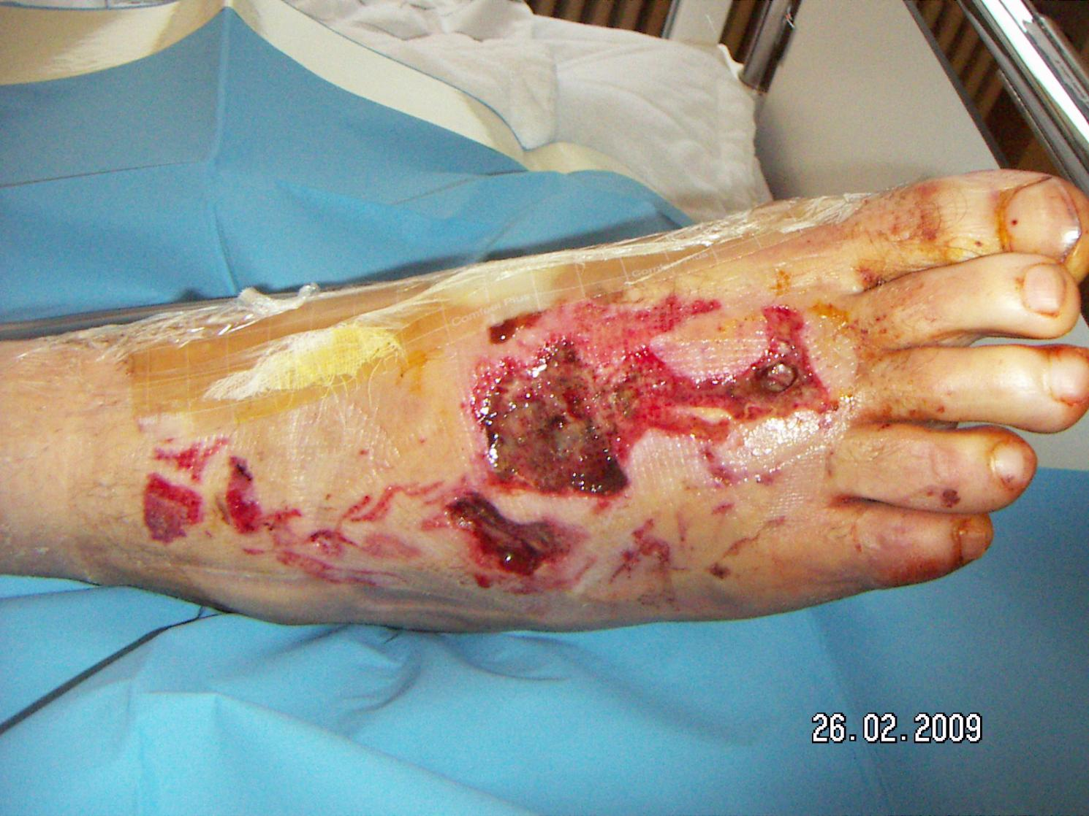
DO YOU WANT THIS TO HAPPEN TO YOU!!!

Slide 3
FACT
The Bureau of Labor Statistics (BLS) notes that there are more than 60,000 foot injuries annually resulting in missed work. Of those injuries more than 2/3 occurred due to employee noncompliance.
Another surprising statistic is that 80% of foot injuries are caused by an impact with an object weighing less than thirty pounds.

Slide 4
CATEGORIES OF FOOT INJURIES
The first category includes foot injuries from punctures, crushing, sprains, and lacerations. They account for 10 percent of all reported disabling injuries.
The second group of injuries includes those resulting from slips, trips and falls. They account for 15 percent of all reported disabling injuries. Slips and falls do not always result in a foot injury but lack of attention to foot safety plays an important role in their occurrence.

Slide 5
OTHER FOOT PROBLEMS
Other conditions such as:
              1. Calluses;
              2. Ingrown toenails or;
              3. Tired feet
Although these may not be considered as occupational injuries in the strictest sense, they can cause discomfort, pain and fatigue. Fatigue sets up the worker for further injuries affecting the muscles and joints. Also, a worker who is tired and suffering pain is less alert and more likely to act unsafely.
An accident of any kind may result.

Slide 6
What are some specific examples of workplace foot injuries?
Injuries | Common Causes
Crushed or broken feet, amputations of toes or feet | Feet trapped between objects or caught in a crack, falls of heavy objects, moving vehicles (lift trucks, bulldozers, etc.), conveyor belts (feet drawn between belt and roller)
Punctures of the sole of the foot | Loose nails, sharp metal or glass objects
Cuts or severed feet or toes, lacerations | Chain saws, rotary mowers, unguarded machinery
Burns | Molten metal splashes, chemical splashes, contact with fire, flammable or explosive atmospheres
Electric shocks | Static electricity, contact with sources of electricity
Sprained or twisted ankles, fractured or broken bones because of slips, trips or falls | Slippery floors, littered walkways, incorrect footwear, poor lighting.

Slide 7
HOW IS THE TYPE OF FOOTWEAR YOU MUST WEAR, DETERMINED?
FOOTWEAR CONSTRUCTION STANDARDS ARE SPECIFIED BY OSHA, ORM AND THE UNIVERSITY SAFETY PLAN
All protective footwear must be constructed in accordance with ASTM Standards F-2415-2005 and F-2413-2005, Standard Methods for Foot Protection and Standard Specification for Performance Requirements for Protective Footwear, respectively.

Slide 8
CHARACTERISTICS OF SHOES WORN BY ALL EMPLOYEES IN THE TRADES
Must fit comfortably without slipping or pinching foot or toes;
Must be made of leather, rubber or strong synthetic material;
Must provide good foot support;
Must have low heals and nonskid soles;
Must be in good condition;
Must be fastened securely.
SANDALS, OR OPEN OR OPEN-TOED, OR SOFT-SIDED, OR WORN SHOES ARE PROHIBITED AT ALL TIMES WHEN AT WORK.

Slide 9
ADDITIONAL FOOT PROTECTION IS REQUIRED IF THERE IS RISK OF INJURY DUE TO:
A heavy object falling or large animal stepping on the foot;
A heavy object rolling over the foot;
A sharp object penetrating the sole of the foot or cutting through the top;
Ignition of flammable or explosive vapors or dusts from static electricity discharged between the
foot and walking surface;
Accidental contact with low voltage (AC>50V < 600 V) live electrical systems;
Contact with high voltage systems;
Chainsaw usage (or similar cut hazard);
Contact with chemicals, potentially infectious human body fluids, or human pathogens;
Molten metals splashing on the foot;
Slips or falls due to wet or slippery surfaces, or rough terrain;
Environmental conditions (e.g., extreme heat/cold, bites from venomous snakes)
YOU MUST WEAR SAFETY SHOES IF YOU WORK IN ANY OF THESE CONDITIONS

Slide 10
How Do You Determine the Type of Footwear to Use and What Are the Consequences For Not Doing So?
Proper footwear, as is the case with all Personal Protective Equipment (PPE), is determined by the operational protocol for each task an employee performs and the conditions under which those tasks are performed.
Under no circumstances shall a person knowingly be subjected to a hazardous condition without the use of appropriate PPEs and it is mandatory that all employees wear such PPEs when there is any risk of hazard exposure.
Failure to do so will subject the errant employee to disciplinary action. Such discipline is covered in the regulations of the Louisiana Department of State Civil Service and University Policy 1414. It is the responsibility of the individual in charge of the activity to assure that safety practices, including the proper use of PPEs are adhered to and to take appropriate actions when this is not done.
SOURCE: Louisiana Tech University Policies and Procedure 4211.

Slide 11
TYPES OF SAFETY SHOES
Safety-toe shoes: Have steel toes and metal reinforced soles.
Conductive shoes: Reduced the possibility of generative a spark.
Foundry shoes: Contain no fasteners to enable quick removal when exposed to molten metal.
Explosive operation shoes: Are non-conductive and have grounding properties.
Electrical hazard shoes: Minimizes the hazard of conducting electricity (have no metal in them).
Chemical hazard shoes: Composition is specified in the MSDS for the chemical being used.
Temperature/moisture hazard shoes: Shoes must be insulated and water proof.
Puncture protective shoes: Shoes must be puncture resistant rated.
Chainsaw protective shoes: Cut resistant, puncture resistant, high top.

Slide 12
ASTM TOE IMPACT RATING
Safety shoes or boots with impact protection are required when carrying or handling heavy materials/objects such as packages, parts or heavy tools, which could be dropped or fall onto the feet.
Two classes of toe impact resistance are available (Class 30 has been eliminated from rating):
• Class 50 provides protection against exposure to impact energy of 67.8 J (50ft-lbf), which is approximately the force created by an item dropped directly on the toe weighing 50 pounds and dropped from a height of 12inches.
• Class 75 provides protection against exposure to impact energy of 101.7 J (75ft-lbf), which is approximately theforce created by an object dropped directly on the toe weighing 50 lb. and dropped from a height of 18 inches.

Slide 13
ASTM TOE COMPRESSION RATING
Safety shoes or boots with compression protection are required for work where a heavy object or item may roll over or a heavy animal may step on the toe (e.g., operating skid trucks and pallet jacks, working around bulk paper rolls or heavy pipes, etc.).
In accordance with ASTM performance standards, compression resistant footwear must also meet impact resistance requirements. Again, there are two classes for compression resistance.
•Class 50 = Provides protection against exposure to a compressive force of 1750 lbf.
•Class 75 = Provides protection against exposure to a compressive force of 2500 lbf

Slide 14
ASTM METATARSAL PROTECTION
Safety shoes with metatarsal protection protect the bones of the upper foot from compression and impact.
In accordance with ASTM performance standards, they must also meet minimum requirements for toe impact and compression.
As with toe protection, metatarsal protection is offered as Class 50 or Class 75

Slide 15
ASTM PUNCTURE PROTECTION
Safety shoes or boots with puncture protection are required when there is risk of sharp objects such as nails, wire, tacks, screws, large staples, scrap metal, etc penetrating the sole of the shoe. Must be rated “PR”.

Slide 16
OTHER RATINGS
SOLE SLIP RESISTANT SHOES- Have soles that prevent slipping on slippery surfaces.
ELECTRICAL HAZARD PROTECTION SHOES- Shoes reduce hazards due to contact eith electrically energized parts. Rated as “EH” and must meet ASTM impact and compression standards.
CONDUCTIVE PROTECTION SHOES- Shoes to prevent buildup of static electricity. Do not wear silk, wool or nylon socks. Rated as CD types 1 or 2.
UPPER SHOE PROTECTION SHOES- Protects against substances that may penetrate the upper shoe. The design of the shoe must protect against this.

Slide 17
When buying footwear for work you should take also the following advice:
Do not expect that footwear that is too tight will stretch with wear.
Have both feet measured when buying shoes. Feet normally differ in size. Buy shoes to fit the bigger foot.
Buy shoes late in the afternoon when feet are likely to be swollen to their maximum size.
Ask a doctor’s advice if properly fitting shoes are not available.
Consider purchasing shock-absorbing insoles when a job requires walking or standing on hard floors.
ALWAYS PURCHASE FOOTWEAR FROM A REPUTABLE SHOE MANUFACTURER FROM SALES PERSONS WITH KNOWLEDGE OF ASTM STANDARDS

Slide 18
SUMMARY
Street shoes aren’t always enough foot protection on the job.
Work shoes should be sturdy, in good condition, fit well and meet the protection requirement for the job.
Inspect and maintain your work shoes and repair or replace those that can’t give proper protection.
Prevent foot injuries by identifying foot hazards and select the proper protection level before starting the job; take care not to drop heavy objects; keep aisles and other work areas clear of spills and tipping hazards, and walk, don’t run

Slide 19
IT’S YOUR FEET, SO:
PROTECT THEM !!

Slide 20
SOURCES OF INFORMATION
This workplace program was developed with information from the Canadian Center for Occupational Health and Safety; the American Standards Institute; U.S.Occupational safety and Health Administration, the Texas Department of Insurance, Division of Workers’ Compensation and the Louisiana Tech University Safety Plan and is considered factual at development.

Slide 21
NOW FOR THE QUIZ

Slide 22
QUESTION 1
  If there are no special hazards, it doesn’t matter what shoe you wear on the job.
  a. True
  b. False

Slide 23
Answer to Question 1
The correct answer is “False”. Always wear sturdy shoes with low heal and non skid soles.

Slide 24
Question 2
Occupational safety standards say employer must require employees to use protective footwear when feet could be injured by:
1. motor vehicle accidents
2. Recreational team sports
3. Falling or rolling objects.

Slide 25
Answer to Question 2
The corerct answer is “Falling or rolling objects

Slide 26
Question 3
In addition to wearing proper foot protection, you can also prevent foot injuries by:
  1. Keeping aisles clear of tripping hazards.
  2. Practicing foot-strengthening exercises.
  3. Keeping feet dry.

Slide 27
Answer to Question 3
The correct answer in “Keep aisles free of tripping hazards.

Slide 28
Question 4
Foot injuries from punctures, crushing, sprains, and lacerations. They account for what percent of all reported disabling injuries?

Slide 29
Answer to Question 4
The correct answer is 10% or all reported disabling injuries.

Slide 30
Question 5
What hazards will the shoes you are wearing protect your feet against?

Slide 31
Answer to Question 5
Your answer should be, “All foot hazards I will encounter during the course of my assigned duties at Louisiana Tech”.
IF THIS IS NOT YOUR ANSWER, YOUR ARE NOT IN COMPLIANCE WITH UNIVERSITY POLICIES!!

