Slide 1
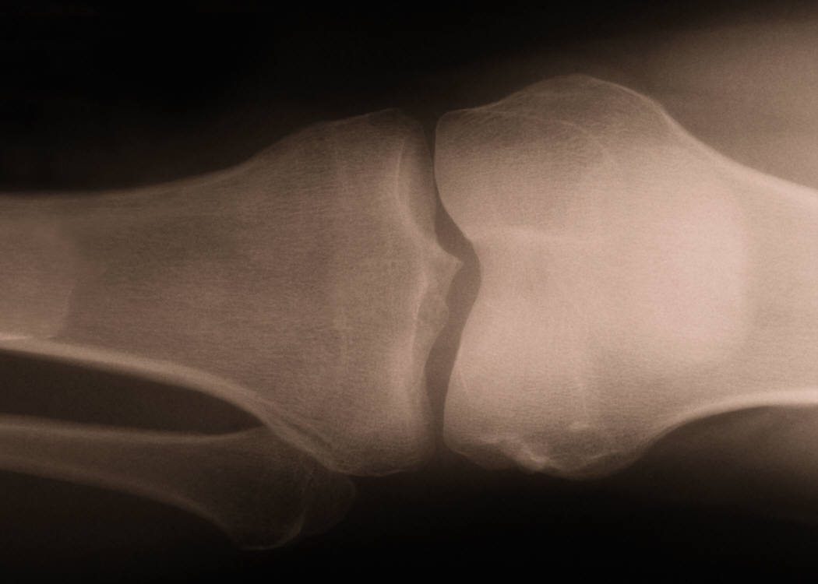
WORK-RELATED MUSCULOSKELETAL DISORDERS (WMSDs)

Slide 2
FACTS!!!!!
WMSDs are the leading cause of human suffering, loss of productivity and economic burden on society
Every year 1.8 million U.S. workers experience WMSDs-back injuries, carpal tunnel syndrome, or tendinitis, for example. Here's another way to look at these numbers. Today, this day, more than 1,500 working Americans will suffer painful injuries related to overexertion or repetitive motion. These injuries are potentially disabling and can require long recovery periods. For example, workers need an average of 28 days to recuperate from carpal tunnel syndrome-more time than necessary for amputations or fractures.
WMSDs are also very costly injuries. Direct costs of MSDs total $15 to $20 billion per year. Indirect costs increase that total to $45 to $54 billion. That's an average of $135 million per day.
From 1992 - 2000, in Washington State, alone, there were 380,485 accepted workers' compensation state fund claims for non-traumatic soft tissue musculoskeletal disorders of the neck, back and upper extremity. These claims resulted in $2.9 billion in direct costs and there were also an average of 123 lost time days per compensable claim.
WMSDs usually develop as a results of repeated trauma, leading to long-lasting injury, though excessive stretching of muscles or tendons or sudden trauma to these organs and to bones which or fractures, lead to injuries that only last a short period of time

Slide 3
THE TYPES OF INJURY WHICH ARE THE MOST COMMON WMSDs ARE:
REPETITIVE MOTION OR REPETITIVE STRAIN INJURIES
CUMULATIVE TRAUMA INJURIES
THIS VIDEO DESCRIBE THE CAUSE AND EFFECTS OF THSE INJURIES

Slide 4
OCCUPATIONAL RISK FACTORS AND SYMPTOMS ON THE MOST COMMON DISORDERS OF THE UPPER BODY ASSOCIATED WITH REPETITIVE MUSCULOSKELETAL STRESS
Disorders | Occupational risk factors | Symptoms
Tendonitis/tenosynovitis | Repetitive wrist motions Repetitive shoulder motions Sustained hyper extension of arms Prolonged load on shoulders | Pain, weakness, swelling, burning sensation or dull ache over affected area
Epicondylitis (elbow tendonitis) | Repeated or forceful rotation of the forearm and bending of the wrist at the same time | Same symptoms as tendonitis
Carpal tunnel syndrome | Repetitive wrist motions | Pain, numbness, tingling, burning sensations, wasting of muscles at base of thumb, dry palm
DeQuervain's disease | Repetitive hand twisting and forceful gripping | Pain at the base of thumb
Thoracic outlet syndrome | Prolonged shoulder flexion Extending arms above shoulder height Carrying loads on the shoulder | Pain, numbness, swelling of the hands
Tension neck syndrome | Prolonged restricted posture | Pain

Slide 5
OTHER REPETITIVE STRESS INJURIES
BURSITIS
SHIN SPLINTS
CALLUSES
BUNYANS
VIBRATION WHITE FINGER
GANGLION CYSTS

Slide 6
CAUSES AND EXAMPLES OF CUMULATIVE TRAUMA INJURIES (CTI)
CAUSED BY USE OF EXCESSIVE FORCE TO PERFORM A TASK.
EXAMPLES OF CTI:
a. Fractures
b. Torn ligaments, tendons or muscles
c. Most of the same injuries what occur with repetitive trauma.

Slide 7
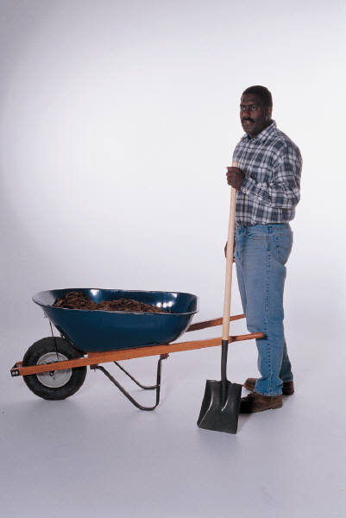
EXAMPLES OF TASKS THAT CAN LEAD TO WMSDs
.

Slide 8
Floor and Ground Level work, such as laying slabs and floors
Requires bending, kneeling, stooping or squatting
Can cause acute pain in back and knees.
Repetition can lead to WMSDs
Some Solutions to minimize these injuries:
Use Fastening Tools that Reduce Stooping
  Use Motorized Concrete Screeds
  Use Rebar-Tying Tools
Use Kneeling Creepers
Use Adjustable Scaffolding for Masonry Work

Slide 9
Overhead Work, such as installing drywall, running wires or pipes in ceilings, painting
Involves reaching, lifting, holding, positioning tools and material with arms outreached over one’s head.
Causes bursitis, tendonitis, rotator cup tears, neck strain, and arthritis.
Some Solutions to Minimize these injuries:
Use Bit Extension Shafts for Drills and Screw Guns Use Extension Poles for Powder-Actuated Tools
Use Spring-Assisted Drywall Finishing Tools
Use Pneumatic Drywall Finishing Systems

Slide 10
Material Handling
Lifting, holding, and handling, loading and pushing, or pulling loads of materials
Results in injuries to shoulders, back, legs and knees, such as herniated discs
Some solutions for minimizing these injuries
Use Lightweight Concrete Block
Use Pre-Blended Mortar and Grout Bulk Delivery Systems
Use Skid Plates to Move Concrete-Filled Hoses
Use Vacuum Lifters for Windows and Sheet Materials
Use motorized lifts, dollys and other material-moving devices

Slide 11
Hand-Intensive Work
You are at risk of injury if you often use a forceful grip on tools, bend your wrist when using them, if the tools vibrate, if you have to twist the tool to use it, or if tool handles that are hard or sharp often press into your hand, wrist, or arm.
These may injure the muscles, tendons, and cartilage of your hand, wrist, and elbow, or damage to the nerves and blood vessels
Some solutions for minimizing these injuries:
Use Ergonomic Hand Tools
Use Easy-Hold Glove for Mud Pans
Use Power Caulking Guns
Use Reduced Vibration Power
Use Electric Snips for Cutting Sheet Metal
Use Quick-Threading Lock Nuts

Slide 12
Solution!!!!!
Change Material or Work Process
Change Tools and Equipment
Change How You Perform Tasks to Ways That Reduce Stress and Strain on your Musculo-skeletal Systems
IF YOU CARE ABOUT YOURSELF AND YOUR FELLOW EMPLOYEE, YOU HAVE GOT TO CHANGE THE MENTALITY THAT, “THIS IS HOW WE HAVE ALWAYS DONE IT” TO “WE CAN DO IT BETTER, SAFER AND CHEAPER.
The money you and your supervisor spends on finding better and safer ways to do what you do and by providing you with the right equipment to do it, IS ONLY A FRACTION OF THE COST OF ONE WORKERS COMPENSATION CLAIM!!!!!!!!
BUT, REMEMBER YOU ARE THE ONLY ONES WHO CAN DO THIS!!!!

