Slide 1
Safety and Risk Management Orientation for Employees
The #1 goal of Louisiana Tech University is to provide an environment that is safe for all its employees, students and visitors.
A text version of this presentation is available upon request.

Slide 2
Safety and Risk Management Orientation for Employees Continued.
As a University employee, the University has developed a safety orientation program to introduce you to:
(1) The General University Safety Policies and Procedures;
(2) The highlights of those topics which the Louisiana State Office of Risk Management, the State of Louisiana, and the University require all new employees to be familiar with, before they begin their assigned tasks. These will be covered in these presentations.
Your immediate supervisor must also provide you with site specific/task-specific safety policies that apply to the individual tasks to which you are assigned.
You must also review the Louisiana Tech University Manual of Policies and Procedures. It is mandatory that you click here to review each policy within the Manual of Policies and Procedures to become familiar with its content.

Slide 3
Policy Review
The Louisiana Office of Risk Management requires all public employees to annually review the written Louisiana Tech University policies on:
· 1308: Online Social Media Usage Policy
· 1401: Equal Employment Opportunity Policy Statement
· 1411: Drug-free workplace Policy
· 1412: Employee Drug Testing Policy
· 1416: Outside /Dual Employment & Dual Office Holding
· 1430: Violence Free Workplace Policy
· 1433: Americans with Disabilities Policy
· 1438: Harassment
· 1439: Discrimination
· 1441: Retaliation
· 1443: Transitional Return to work Policy
· 1451: Child Abuse Reporting
· 4106: Keys for Offices and Buildings
· 4200 through 4222: (Safety Policy and Plan) including 4203: Emergency Guidelines
· 4216: Emergency Response Plan for Faculty & Staff (for Faculty and Staff to review)
· 4217: Emergency Response Plan for Students (for Student Workers and Graduate Assistants to review)
· 5301: Property Regulations and Responsibility
· 6303: Family Educational Rights and Privacy Act
**The policies included in this section of training include the mandatory Drug Free Workplace Training as required by the LA Office of Risk Management.
You will need to click and read each policy in order to complete this training.

Slide 4
Topics to be Covered in This Presentation
Topic 1- Introduction to Risk Management, LA Tech Manual of Policies and Procedures, and Safety Rules and Responsibilities
Topic 2- University Drug-Free Workplace and Drug Testing Policies
Topic 3- Basic Bloodborne Pathogen Training
Topic 4- Louisiana Tech University Sexual Harassment Policies
Topic 5- Policies and Training for Employees That Drive Vehicles as Part of Job
Topic 6- Hazard Communication
Topic 7- Post Accident Drug Testing and Transitional Return to Work Policies
Topic 8- Lockout/Tagout – Affected and Other Employees

Slide 5
Documentation of This Orientation for New Employees
These orientations must be documented by you and your Supervisor on the “New Employee Safety/Risk Management Orientation Form” which was provided to you by the Office of Human Resources. You must also complete and submit the Certificate of Completion found at the end of this course. This form and certificate must be returned to Human Resources on or before 30 days of your date of hire.
You must also review the Louisiana Tech University Manual of Policies and Procedures. It is mandatory that you click here to review each policy within the Manual of Policies and Procedures to become familiar with its content.

Slide 6
Coordinated by:
Louisiana Tech University Office of Human Resources
Ph: 318-257-2235
Louisiana Tech Office of Environmental Health and Safety
Ph: 318-257-2120
Louisiana Tech University Center for Instructional Technology
Ph: 318-257-2912

Slide 7
Part 1- Introduction To Risk Management and Safety Rules and Responsibilities
Objectives
1. Define, “Risk Management” and “Safety”.
2. State the specific responsibilities of, and accountability for, each of the following groups in the University Safety/Risk Management Programs: (a) Agency Head; (b) Dean, Directors, Department Heads; (c) Faculty and Staff; (d) Students; (e) Visitors and Contractors; (f) Office of Environmental Health and Safety; (g) University Police.
3. Review the content of each section of the Louisiana Tech University Safety Plan. It is codified as, Louisiana Tech University Policies 4200 through 4222.

Slide 8
What is Risk Management?
It is a process to reduce different risks related to a preselected domain to the level accepted by society. It may refer to numerous types of threats caused by environment, technology, humans, organizations and politics.
Simply put, Risk Management leads to a reduction in injury/illness rates among employees as well as property losses.

Slide 9
What is Safety?
Safety is the quality or conditions required to be free from danger, damage, or injury.

Slide 10
Why Do We Have And Must Follow Safety Rules and Risk Management Policies?
To reduce illness and injury to faculty/ staff, students and the community-at-large.
To create an atmosphere which is more conducive to learning.
To teach students the safety rules/ regulations which they must follow in their future employment.
To reduce liability.

Slide 11
Safety is Everyone’s Responsibility!!
Budget Unit Heads - Provide the resources necessary to maintain, and are accountable for the University’s and unit’s safety programs.
Faculty/Staff/Student/Visitor/Contractor- Know and observe all safety rules.
Occupational Health and Safety Office and University Police- Provide guidance to Budget Unit Heads and as a liaison with regulatory agencies.
University Safety Committee- Reviews and recommends adoption of ALL University Safety Policies.

Slide 12
What Are Your Safety Responsibilities?
Your general responsibilities for safety are in the “Assignment of Safety Responsibilities” section of the University Safety Plan. You must review these when hired and at least annually. It is codified as, Louisiana Tech University Policies 4200 through 4222. It is mandatory that you click here to review each section of the Safety Plan to become familiar with its content.
Additional site-specific/task-specific responsibilities are assigned to you by your Budget Unit Head when you are hired or have a job change. You must also review these with your supervisor at least annually.
You must participate in quarterly Safety Meetings.
You must participate in site-specific/task-specific Safety Training as directed by your Supervisor.

Slide 13
Means of Compliance
The University’s and Budget Unit-Specific Risk Management/ Safety Plans are Based On the Policy Requirements of Many Agencies and All Must Be Followed to Be In Compliance.

Slide 14
Ramifications
Failure to follow the standards set forth by these agencies jeopardizes funding as well as the leveling of fines and other penalties against the errant employee and their employer!

Slide 15
Location of Rules That Must be followed to be in Compliance With These Regulations
Most of the general safety and risk management policies specified by the State of Louisiana Office of Risk Management and other federal, State and Local Agencies are addressed in the Safety Plan. It is codified as, Louisiana Tech University Policies 4200 through 4222. It is mandatory that you click here to review each section of the Safety Plan to become familiar with its content.
These policies and plan are located in all Budget Unit offices and at: http://www.latech.edu/administration/policies-and-procedures/. It is mandatory that you go to this website and review each section of the Safety Plan and all other policies and procedures contained within the Manual of Polices and Procedures to become familiar with its content.

Slide 16
Other University Safety/Risk Management Policies and Rules
These are :
Louisiana Tech University Biohazard and Radionuclide Institutional Review Committee (BRIRC) Guidelines located at:
https://research.latech.edu/?s=BRIRC
Site-specific/task-specific rules which have been developed, and enforced by each Budget Unit that address unique safety/risk management federal, state and local regulations which apply to that unit and the tasks performed therein.

Slide 17
Remember…..
All of these rules are in place to protect you, your fellow workers, our students and our neighbors, and safety is everyone’s business

Slide 18
Part 2- University Drug-free Workplace and Drug Testing Policies

Slide 19
Drug Free Workplace Education and Awareness
Who are the Substance Abusers?
They can be anyone:
  They cross all demographic, geographic & labor management lines.
  Looks, talks and acts like everyone else.
  They can be part of any agency or workplace.
Negative effects of drug abuse:
  Abusers are not safe;
  Abusers are less productive;
  Abusers work is of poor quality.
Notes:
No matter who or where you are, this problem is truly an “equal opportunity” dilemma that is effecting everyone, (in some way) regardless of your socio-economic classification.
In many ways, it is extremely difficult to detect.
Poor job performance is a “key” to detecting and handling/managing a suspected drug abusing employee. In many cases, this is the first “noticeable” observation that anything is in fact wrong with an employee.

Slide 20
Drug Free Workplace Program
Louisiana Tech University strives to maintain a safe and healthy environment for its students, employees and visitors. To support these efforts, the university has adopted and implemented a multi-phase drug-free workplace program, with Drug-free Workplace Policies, including a Tobacco-Free Workplace Policy, and an Employee Drug Testing Policy. The purpose of the program is to address the illegal or improper use of drugs and alcohol by members of the university community and to assist any errant employee.

Slide 21
A Drug Free Workplace Program Includes:
Written Policy
Education & Awareness Program
Supervisor Training
Employee Assistance Program
Drug Testing Procedures
Notes:
This is taken straight out of the Office of Risk Management’s (General) State Loss Prevention Audit, question # 13

Slide 22
The University Drug-Free Workplace Policies:
Are tailored to La Tech’s specific drug-free workplace needs
Assigns responsibility for the Program
Identifies Safety/Security Positions
Must be disseminated to all employees
Mandates drug testing in accordance with Executive Order KBB 05-08 &05-11
Specifies violation of Policy actions
The Louisiana Tech University Drug-free Workplace Policy is found at: https://www.latech.edu/administration/policies/p-1411/
The Louisiana Tech University Employee Drug Testing Policy is found at: https://www.latech.edu/administration/policies/p-1412/
IT IS MANDATORY THAT YOU GO TO THESE SITES AND REVIEW THESE POLICIES
Notes:
Responsibility – carrying out the various phases of the drug testing.
Safety/Security Sensitive Positions – are determined the appointing authority of each agency (if any; may not apply)
Dissemination to all employees – as this may affect all employees, it is mandated that all must be given this information, and some form of proof (signature in most cases) be secured by the agency (that they have read/heard/understood the material and had the opportunity to have all questions answered) to have in the event it is needed later.
Violation of policy - refusal to submit to testing will result in actions up to and including termination of employment. This statement is of course to be included in the agency’s written policy. You can not hold an employee responsible for your policy if you have not notified them of it.
Must be reviewed by the Justice Department prior to promulgating your Drug Testing Policy.

Slide 23
Executive Orders KBB 05-08 & 08-11
They mandate testing as follows:
When reasonable suspicion exists
Following an accident that:
  Leads to reasonable suspicion
  Results in a fatality
  Could result in a Worker’s Compensation claim
Results in the release of a hazardous waste or material
Randomly as a part of a rehabilitation monitoring program
Pre-employment for both employees/appointees
Randomly for all employees in a safety/security sensitive position
Prior to promotion/reassignment to a safety/security sensitive position.
Notes:
Not all agencies are mandated by the order – Judicial, Legislature, etc.
1. The following are examples of “reasonable suspicion” as they relate to Poor Job Performance:
Inconsistent Work Patterns
Interpersonal Work Relationships
General Job Performance
Quality & Quantity of Work
On-the-Job Absenteeism
Difficulty in Concentration
2. Following an accident:
A) May be required if leads to reasonable suspicion
B) Required if a fatality occurs
C) Required if there is a Hazardous Material or Waste is released, Hz. Waste as defined in R.S. 30:2173(2) or Hz. Materials in R.S. 32:1502(5)

Slide 24
Targeted Substances in the Mandated Testing Program
Marijuana
Opiates (narcotics)
Cocaine
Amphetamines
Phencyclidines(PCP)
Notes:
Marijuana effects:
Reddened eyes
Slowed speech
Distinctive of odor on clothes
Opioids effects:
Mood changes
Constricted pupils
Impaired Coordination
Cocaine effects:
Runny, irritable nose
Talkativeness
Wild mood swings
Amphetamines effects:
Restlessness
Hyper excitability
Heightened aggressive behavior
PCP effects:
Extreme agitation
Extreme mood swings
Jerky eye movement

Slide 25
Confidentiality Requirements
All drug testing is considered confidential pursuant to LRS 49:1012
Information cannot be used against an employee except where drug use is considered relevant
Notes:
Relevant if in an administrative hearing, or disciplinary proceeding, or in a civil litigation.
(relevant is the loaded word!)

Slide 26
If Test Results are Positive:
The Agency may, but are not required to, allow current employee to undergo rehabilitation without termination.
Prospective employees/ appointees will be eliminated from consideration for employment or appointment.
Notes:
ALWAYS refer to your policy!
DO NOT vary from this, as in showing partiality, or treating an employee different from others for the same violation. This could give an employee cause for legal action against the State. (be careful not to do give an employee grounds for things such as discrimination, slander, or defamation of character)

Slide 27
Policy 4202 - Tobacco-Free and Smoke-Free Campus Environment
Summary/Purpose: Act 211 of the 2013 Louisiana State Legislative session directs all public post-secondary educational institutions to develop smoke-free policies for its campuses. Nothing in this law prohibits institutions from developing a tobacco-free policy. Therefore, Louisiana Tech University has approved this policy to provide notice of and guidelines about the tobacco-free and smoke-free environment at the University.
Click here to review the policy to become familiar with its contents.

Slide 28
Prohibited Products and Locations
Smoking and the use of all tobacco products, including but not limited to cigarettes, cigars, cigarillos, pipes, hookah-smoked products, e-cigarettes, and oral smokeless or spit are prohibited at all times, and at all locations of Louisiana Tech University including University-owned or leased facilities, properties, and grounds. The University also prohibits littering the campus with remains of any tobacco products. Additionally, the University-controlled advertising, sale, or free sampling of tobacco products is prohibited on campus, regardless of the vendor.

Slide 29
Responsibility for Tobacco-Free and Smoke-Free Campus Environment
Respect and Responsibility: The success of this policy depends on the thoughtfulness, consideration, and cooperation of users and non-users of tobacco products. All members of the University community share in the responsibility for adhering to and enforcing this policy. Courtesy and consideration shall be exercised when informing violators of the policy. Any complaint should be brought to the attention of the appropriate University authorities. Anyone who complains shall be protected against retaliation.

Slide 30
Policy 4202 -Enforcement
Enforcement
Civility and respect are expected by all members of the University community in regards to this policy.
Violations of the policy should be referred to the appropriate administrative office for review and action: for academic employees, the Office of Academic Affairs; for staff, the Office of Human Resources; and for students, the Office of Student Affairs.
Violations may also result in a citation by law enforcement in accordance with State law.

Slide 31
Smoking Cessation Programs
Additional information may be found at 1-800-QUIT-NOW (1-800-784-8669)

Slide 32
Part 3- Basic Bloodborne Pathogen Training

Slide 33
Rationale For This Training
To remind employees of the dangers of an exposure to bloodborne pathogens.
To review measures that employees must take to minimize their exposure to these pathogens.
Refresher training is required by the regulations of the State of Louisiana.
Refresher training is required by federal regulations every 3 years.
Non-compliance with these regulations can result in loss of federal funds and possibly lead to litigation against the University and to individual “high risk” employees.

Slide 34
Objectives
1. Define occupational risk for exposure to bloodborne pathogens.
2. Identify individuals with greatest risk of exposure to bloodborne pathogens at Louisiana Tech University.
3. Identify the bloodborne pathogens to which individuals may be exposed at Louisiana Tech University.
4. Identify the components of the Louisiana Tech University Exposure Control Plan for Bloodborne Pathogens.
5. Discuss the action taken by participants when exposure to bloodborne pathogens occurs in their workplace.

Slide 35
Bloodborne Pathogen Exposure Risk, defined….
“High Risk” employees are those who are assigned tasks in which they can reasonably anticipate skin, eye, mucous membrane or parenteral contact with human blood and other potentially contaminated body fluids or tissues.
“Low Risk” employees are those who do not routinely perform task that are deemed “high risk”.
Any employee, regardless of risk category, must report any occupational exposure they may have and the exposure must be processed according to University Policy.

Slide 36
High Risk Groups are:
Faculty and other instructional/research personnel who use or potentially come in contact with HUMAN fluids or tissues in teaching, service or research activities
Student Health Personnel
Custodial Personnel (If they handle blood-contaminated linens or cleanup blood/body fluid spills)
First Responders
Plumbers
Athletic Trainers
Environmental Health and Safety Personnel
Other “High Risk” Personnel as Identified by their Budget Unit Head
ALL OTHER EMPLOYEES ARE CONSIDERED TO BE “LOW RISK” FOR EXPOSURE TO BLOODBORNE PATHOGENS

Slide 37
Supervisor’s Responsibilities for “High Risk” Employees
Federal and State Law and Louisiana Tech University Policies mandate that supervisors identify all tasks that are performed by employees under their supervision in which an employee could be routinely exposed to human blood, body fluids or tissue. Such employees are deemed as “high risk”. Tasks that place an employee at “high risk” must be approved by the Louisiana Tech University Biohazard and Radionuclide Institutional Review Committee. In addition, the names of these employees must be reported to the Office of Environmental Health and Safety. Once approved, supervisors must schedule “high risk” Advanced Bloodborne Pathogen training for these employees with EHS and for training updates every year thereafter. Training must be completed, prior to employees commencing duties that place them at “high risk” for exposure.
The supervisor is both responsible and accountable for these reporting requirements.
Notes:
Supervisors are the “gate keepers” for compliance with these regulations and for the overall safety of their employees and students. As such, they have these two responsibilities in the Louisiana Tech Exposure Control Plan.

Slide 38
BLOOD-BORNE PATHOGEN TRAINING
Training is a MUST for All Employees!!
All new employees (both “high Risk” and “low risk”) must successfully complete a blood-borne pathogen awareness course within 30 days of hire. All “low risk” employees must attend a refresher course every three years. It is mandatory that you click here to review Policy 4215 – Exposure Control Plan for Bloodborne Pathogens (ECP).
All employees who meet the ORM/OSHA definition of being at “high risk” for exposure to blood-borne pathogens must also complete an advanced blood-borne pathogen training course provided by the Office of EHS, BEFORE BEGINNING ANY HIGH-RISK DUTIES. YOU MUST SCHEDULE THIS TRAINING, DIRECTLY WITH EHS. Additional refresher training is also required, annually.
Notes:
Identify the Category to which you belong and following the appropriate training instructions.

Slide 39
What are these Bloodborne Pathogens?
Hepatitis B and C, HIV are the bloodborne pathogens that could be encountered in your workplace.

Slide 40
Transmission and Preventative Measures
Mode of Transmission of HB B,C and HIV: Entrance of infected human blood or other body fluids into the body of an uninfected person through cuts, needle sticks, sexual contact or from infected mother to fetus.
Primary Preventive Measures: Wear latex gloves when handling body fluids; wear latex + puncture-resistant gloves when working in sewer; never handle trash in trash containers; don’t share razors, toothbrushes, needles; wear condoms; refrain from having tattoos or body-piercing; Get Hepatitis B vaccine (if in a high risk category)

Slide 41
Potentially Infectious Materials (PIM) Included in These Regulations
These human body fluids: (A) blood; (B) vaginal secretions; (C) cerebrospinal fluid; (D) synovial fluid: (E) pleural fluid; (F)pericardial fluid; (G) peritoneal fluid; (H) amniotic fluid; (I) semen ; (J) saliva contaminated with blood (K) all body fluids in situations where it is difficult or impossible to differentiate between body fluids
Any unfixed tissue or organ (other than intact skin) from a living or dead human.
HIV-containing cell or tissue cultures, organ cultures, and HIV- or HBV-containing culture media or other solutions;
Blood, organs or other tissues from experimental animals infected with HIV or HBV.

Slide 42
Common Routes of Exposure to These Pathogens in Your Workplace?
Being stuck with a contaminated sharp object such as a needle
Entry of pathogens from contaminated material into a wound, burn or other break in the skin
Splashing of contaminated materials into eyes, nose or mouth
Entry through sexual contact with an infected person
Bites from HIV or HBV-infected laboratory animals

Slide 43
What must you do to protect yourself and others from these agents and to comply with the law?
Stay informed by reading and following the Louisiana Tech University Exposure Control Plan for Bloodborne Pathogens
Practice Universal Precautions
Be properly trained in how to safely perform you assigned tasks

Slide 44
Pertinent Documents
Federal OSHA Bloodborne Pathogen Standards
Louisiana Tech University Policy 4215- Exposure Control Plan for Bloodborne Pathogens ( The “Plan”)
Louisiana Tech University Policy 4202- Emergency Guidelines, including Medical and First Aid
Site Specific/Task Specific Bloodborne Pathogen Action Plans developed by Individual Budget Units

Slide 45
Scope of the Exposure Control Plan
The “Plan” covers all employees who could be “reasonably anticipated” as a result of performing their job duties to come in contact with human blood, blood components, human body fluids, un-fixed human tissue and/or HIV- or HBV- containing cultures.
It identifies task, procedures and job classifications within the University where occupational exposure to blood or other potentially infectious materials may could be “reasonably anticipated”
It dictates the schedule for implementing the other parts of the Standard;
It contain a “Responsibility Matrix” which list those who are accountable for implementing and updating the Plan

Slide 46
Scope of the Exposure Control Plan- Cont’d
It contains a written procedure for evaluation of exposure incidents
It contains a process for review and update of the Plan to reflect new procedures, tasks, or processes where occupational exposure may occur.
It contain a process for review and update of the Plan to reflect new or revised employee positions in which occupational exposure may occur are identified

Slide 47
Exposure Control Plan- Methods of Compliance
Universal Precautions
Engineering and Work Practice Controls
Personal Protective Equipment
Housekeeping
Hepatitis B Vaccinations
Post-exposure Evaluations and Follow-up
Hazard Communication ( Labels and Signs)
Recordkeeping
Cleanup of Spills

Slide 48
Exposure Control Plan-Post Exposure and Follow-up Plan
All exposures to human blood or other body fluids which occurs via stick, splatter, ingestion must be reported to the supervisor, IMMEDIATELY. If injuries are involved, follow University Policy 4203- Emergency Guidelines/ Medical and First Aid.
The Supervisor must complete an Incidence Report Form to document the Exposure and/or accident.
At a minimum, the Incidence Report must contain, for each incident: (1) Route of Exposure; (2) Type and brand of device involved in the exposure; (3) Identification of the source individual from which the body fluid came; (4) Department or area where the incident occurred; (5)Description of incident

Slide 49
Exposure Control Plan-Post-Exposure Follow up Plan -Cont’d
The University Student Health Center shall conduct a confidential medical evaluation of the exposed employee to include:
Documenting circumstance of exposure ;
Collecting blood from the source individual ( if known) for HBV and HIV serological testing. Results of the source individual’s testing is made available to the exposed employee;
Collecting and testing exposed employee’s blood for HBV and HIV serological status;
Providing post exposure prophylaxis as recommended by the USPHS when medically indicated;
Providing post exposure counseling;
Follow up serological testing and treatment, if necessary.

Slide 50
Exposure Control Plan- Recordkeeping
Medical records on each employee with occupational exposure to BBP must be kept for the duration of employment + 30 years;
All medical records must be kept confidential and are not available to the employer;
All medical records must be made available to the employee

Slide 51
EXPOSURE CONTROL PLAN- REMOVING BLOOD/BODY FLUIDS
Human blood or body fluids should be cleaned up immediately after they are discovered.
1. Report such spills to your immediate supervisor.
2. Follow the procedure for cleaning up blood/body fluid spills that is located in the Exposure Control Plan

Slide 52
Exposure Control Plan- Hazard Communication
Warning labels which include the OSHA Biohazard symbol must be affixed to containers of regulated waste and refrigerators/freezers or other containers used to store or transport blood or potentially infectious materials. Do not store food or drink for human consumption in these areas.

Slide 53
Additional Resources
Human Immunodeficiency virus: http://www.cdc.gov/hiv/default.htm
Hepatitis B: http://www.cdc.gov/hepatitis/B/index.htm
Most Frequently Asked Questions Concerning the Bloodborne Pathogens Standard: https://www.osha.gov/laws-regs/standardinterpretations/1993-02-01-0
Consult your Budget Unit Head or the Office of Environmental Health and Safety if you have any questions about the University’s Bloodborne Pathogen policies.
Sections of Presentation Provided by: U.S. Department of Labor, OSHA, 200 Constitution Avenue NW, Room N-3603, Washington, DC 20210

Slide 54
Part 4- Louisiana Tech University Sexual Harassment Policies
Prepared by: Louisiana Tech University Office of Human Resources, Louisiana Tech University Office of Environmental Health and Safety, and Louisiana Office of Civil Service

Slide 55
Why train on the subject of sexual harassment?
Every employee has the right to be treated with respect. Respectful behavior facilitates more productive employees.
Training restores harmony to the workplace and learning
Sexual harassment is illegal.
Annual Training is required by State Law and the University and the Louisiana Office of Risk Management.

Slide 56
Why train…? (Continued)
5. Comprehensive policies, training, and appropriate investigations can limit the liability of the University for the actions of their employees.
6. Violations of Title IX—Education Amendments of 1972, and Title VII—1964 Civil Rights Act (federal legislation prohibiting sexual discrimination in employment) can result in monetary damages,
attorney’s fees, compensatory and punitive damages.

Slide 57
Sexual Harassment Policies
Go to Policies | Louisiana Tech University (latech.edu) and scroll down to the policies listed below and review each one.
Policy 1436, 1436A, 1436B, 1436C – Policy Procedures for Addressing the Issues Concerning Sexual Harassment
Policy 1437
Policy 1441 – Retaliation
Policy 1450 – Consensual Relationships
It is mandatory that you review each policy listed above to become familiar with its content.

Slide 58
Part 5- University Driver Safety Training Policies
All New and Continuing Employees who must travel/drive as part of their job duties, must be certified by the State to do so.
Instructions on how to become certified can be found at:
Drivers Safety Program
No employees are to travel/drive on State business until after they have been notified by the Office of Environmental Safety that the State has certified them.

Slide 59
Topic 6- Hazard Communication

Slide 60
Hazard Communication Training Requirements
The U.S. Occupational Safety and Health Administration (OSHA) and the Louisiana Office of Risk Management (ORM) mandate that ALL new employees be trained on the revised Hazard Communication Standard for chemicals used in the workplace. This training is part of Louisiana Tech University Policy 4212 – the University Hazardous Communication Plan. It is mandatory that you review this policy here. Many of these chemicals are also designed for use at home and information in this Standard also applies to these chemicals. This training must be completed within 30 days of employment.

Slide 61
What are the New Requirements?
Newly revised federal standard which ALL employees must be made aware of are:
The use of a standardized format for Safety Data Sheets (SDS), formerly known as, Material Safety Data Sheets (MSDS).
The use of new GHS labeling elements for these chemicals.

Slide 62
Hazard Communication Training Resources
The SDS and GHS Labeling System training for all new employees is found in the following assignments:
Read the “OSHA Briefs- “Hazardous Communication Standard: Safety Data Sheet”. Pay particular attention to how the content of each of the 16 sections of a SDS apply to an employee’s use of a particular chemical.
View the tutorial, “Understanding the GHS Labeling System”. Again, pay particular attention to how this labeling system applies to the employee’s use of a particular chemical.
Review the Louisiana Office of Risk Management PowerPoint Hazard Communication. PowerPoint is also available here: https://www.doa.la.gov/doa/orm/loss-prevention/

Slide 63
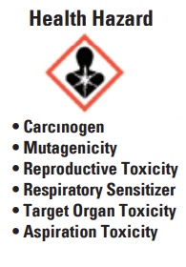
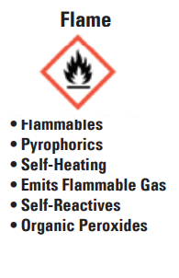
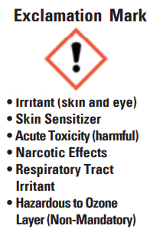
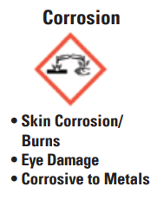
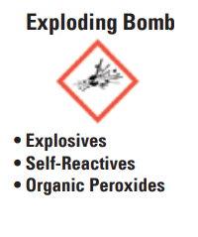

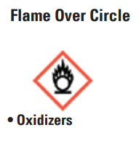
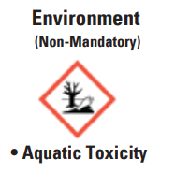
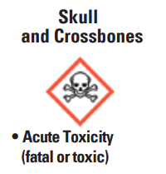
HCS Pictograms and Hazards
There are nine pictograms under the GHS to convey health, physical and environmental hazards. The final Hazard Communication Standard (HCS) requires eight of these pictograms, the exception being the environmental pictogram, as environmental hazards are not within OSHA’s jurisdiction. The hazard pictograms and their corresponding hazards are shown below.

Slide 64
Hazard Communication “High Risk” Training
New employees who are likely to routinely encounter hazardous materials in the course of a work shift are considered, “high risk employees”. OSHA and ORM mandate that they MUST have further documented hazardous material training as described in the University Hazardous Communication Plan. The training must be appropriate for and commensurate with, the nature of the work or exposure. This training must be completed within 30 days of employment.

Slide 65
Documentation of Hazard Communication Training
These “high risk” employees must also have additional documented refresher training on the full Hazardous Communication Plan:
Any time that they are assigned work with a new hazardous material and/or;
At least annually.

Slide 66
Responsibilities for Hazard Communication Training
An employee’s immediate supervisor is responsible for all hazardous communication training.
New employees and their supervisor must verify this training on the “New Employee Safety and Risk Management Orientation Form” and the course “Certificate of Completion”.

Slide 67
Topic 7- Louisiana Tech University Worker’s Compensation and Transitional Return to Work Policies

Slide 68
Program Administration
The Louisiana Tech University Office of Human Resources is responsible for the administration of the Louisiana Tech University Worker’s Compensation and Transitional Return to Work Programs.

Slide 69
What is to be Done When an Employee Has a Work-related Injury or Illness?
When an employee experiences a work-related injury or illness which may result in a Worker’s Compensation claim, the employee’s supervisor must contact the Louisiana Tech University Office of Human Resources (HR).
HR will arrange for a post accident drug test of the injured employee and assist the supervisor in completing a Form LWC-WC 1A-1, “First Report of Injury or Illness. This form must be filed with the State’s Third Party Administrator (TPA) immediately.

Slide 70
Post-Accident Drug Testing
Drug-Testing is required after an accident involving any of the following:
  An accident that requires (or should require) medical attention to the employee
  An accident leading to a reasonable suspicion of illegal drug or alcohol use
  An accident involving a fatality
  An accident involving hazardous waste.
  You must review Policy 1412 – Employee Drug Testing Policy to become familiar with its contents.

Slide 71
Monitoring of the Injured/Ill Employee
HR will provide the injured/ill employee with a “Functional Capacity Form” (FCF) that must be completed by the physician treating the injury/illness. The employee must return the completed report to their supervisor within 24 hours of the injury/illness.
The employee is to provide regular updates to the employee’s supervisor on at least a bi-monthly basis.

Slide 72
Return to Work Goals
Louisiana Tech University makes a reasonable effort to return to the workplace those employees who have sustained job-related injuries or illnesses and are temporarily prevented from returning to work.
The University strives to place such an employee into a meaningful assignment with light/limited duties on a temporary basis (not to exceed 6 months).
You must review Policy 1443 – Transitional Return to Work Policy to become familiar with its content.

Slide 73
Return to Work Goals- Cont’d
The employee will be allowed to return to a modified duty arrangement when such arrangement align and comply with medical restrictions set by the treating physician as determined by a case management team.
In instances where the employee’s department is unable to find a suitable duty arrangement, a case management team will assist in determining an appropriate duty arrangement.

Slide 74
Return to Work Case Management Team
The case management team’s duties include:
  reviewing physician restrictions and requesting a second medical opinion when appropriate;
  Assessing to what extent the restrictions will impact the employee’s ability to perform;
  Determining the work load, schedule, and any modification of duties;
  Analyzing whether the employee’s current position can be altered to accommodate the modified schedule/duties or whether another more appropriate position is available.

Slide 75
Return to Work Accommodations
If the employee’s department cannot accommodate the employee, the department must notify the case management team with written reasons for the determination. The case management team will review and determine if alternative arrangements can be made.
If the employee refuses an accommodation or reassignment which are within the employee’s restrictions and ability to perform, the University is not obligated to provide alternatives.

Slide 76
Questions about Worker’s Compensation and Transitional Return to Work are to be referred to:
Shelia S. Trammel- Director
Louisiana Tech University Office of Human Resources
Phone: 318-257-2235
E-mail: strammel@latech.edu

Slide 77
References:
Louisiana Tech University Policy 1443
Frequently Asked Questions From Employees and Employers about Rights and responsibilities in Worker’s Compensation-Louisiana Workforce Commission
2016 Loss Prevention Manual- Loss Prevention Unit of the Louisiana Office of Risk Management
Louisiana State Office of Civil Service General Circular #001290

Slide 78
Topic 8- Lockout/Tagout – Affected and Other Employees
This training will help you understand your role and responsibilities when dealing with energy systems in use at the University. Lockout/Tag Out is specifically designed to protect employees from accidental discharges of energy.
Affected employee: An employee whose job requires him/her to operate or use a machine or equipment on which servicing or maintenance is being performed under lockout or tagout, or whose job requires him/her to work in an area in which such servicing or maintenance is being performed. Affected employees and all other employees are required to recognize when energy control procedures are being used, understand the purpose of the procedure, and understand the critical importance of not attempting to start up or use equipment that has been locked out or tagged out.

Slide 79
Lockout/Tagout – Affected and Other Employees Continued
Authorized employee: A person who locks out or tags out machines or equipment in order to perform servicing or maintenance on that machine or equipment. An affected employee becomes an authorized employee when that employee's duties include performing servicing or maintenance covered under this section. The lockout/tagout standard requires that before the machine or equipment is turned off, the authorized employee must be knowledgeable of the following:
Recognition of applicable hazardous energy sources.
Details about the type and magnitude of the hazardous energy sources present in the work area.
The methods and means necessary to isolate and control hazardous energy sources.

Slide 80
Click the link below to complete Lockout/Tagout – Affected and Other Employees training.
Lockout/Tagout Affected Employess – YouTube

Slide 81
FOR NEW EMPLOYEES ONLY
INSTRUCTIONS FOR SUBMITTING CERTIFICATE OF COURSE COMPLETION
STEP 1:
Fill out all required fields on the “New Employee Safety/Risk Management Orientation Certificate of Completion” AND the “New Employee Safety and Risk Management Orientation Form.”
STEP 2:
Have your immediate supervisor sign and date both documents to verify that you have completed this orientation
STEP 3:
Submit both documents to the Louisiana Tech University Office of Human Resources within 30 days of your initial hire. Save copies of both for your files.
A sample of both documents is found on the following slides.

Slide 82
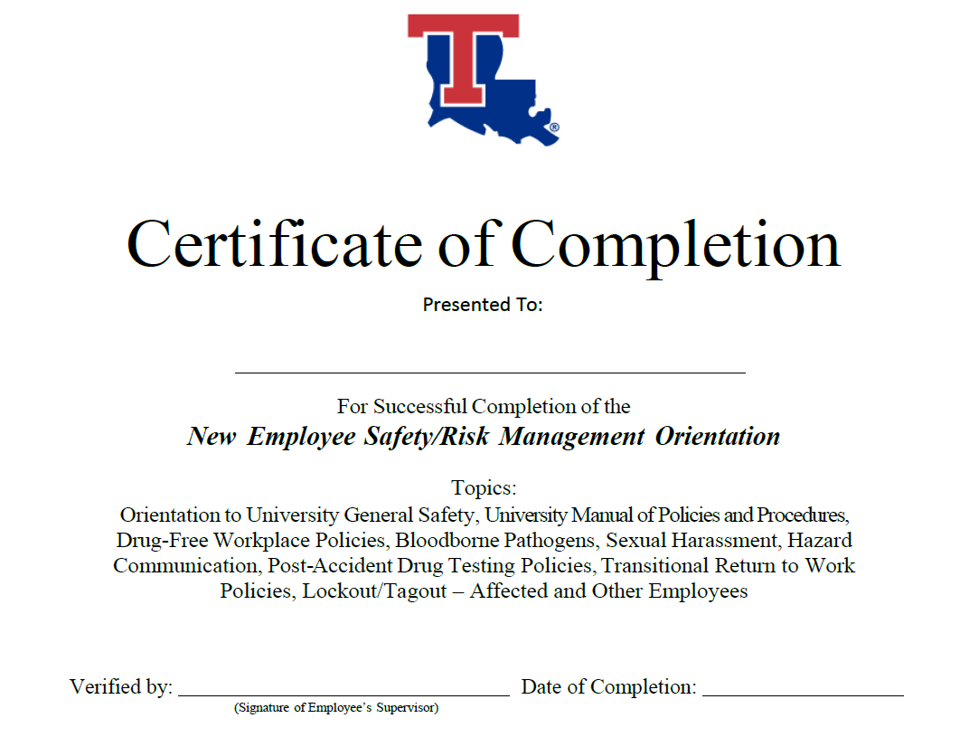

Slide 83
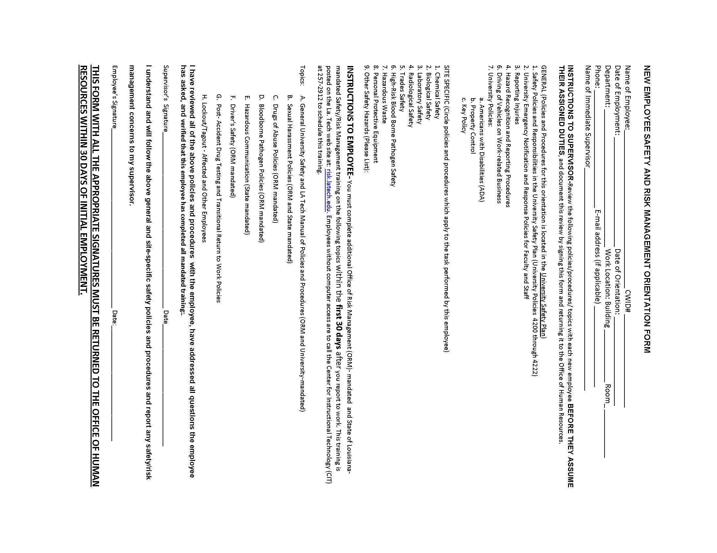

Slide 84
END OF COURSE

